Slide 1
How Prior Learning Assessment Can Support Adult Student College Completion
Illinois Network for Advanced Manufacturing (INAM)
October 29, 2013

Slide 2
Presenter
Donna Younger, Ed.D.
The Council for Adult and Experiential Learning
(CAEL)
www.cael.org

Slide 3
What Is CAEL?
A 501(c)3 non-profit, international organization with nearly 40 years of experience
Dedicated to removing barriers to adult learning

Slide 4
CAEL’s Overarching Goal:
Meaningful Learning, Credentials, and Work for Every Adult
CAEL links learning and work – for nearly 40 years

Slide 5
Why Focus on Adults?
In order to become competitive, the U.S. must increase the numbers of college graduates. But… the pipeline of young college graduates is in decline and will not be enough to meet future workforce skills demands.

Slide 6
To Remedy the Shortfall
Outreach to:
Adults (25-64) who never completed high school
Adults with high school diplomas but no college
Adults with some college but no degree

Slide 7
The Climate Is Right
Who is addressing adult degree completion and PLA?
President Obama
Departments of Education and Labor
Individual States
Philanthropic Organizations
Chambers of Commerce
Individual Institutions

Slide 8
What Are Adults Saying?
Incentives to return to school…

Slide 9
What Are Adults Saying?
Gallup/Lumina Poll: Feb. 5, 2013
“[Respondents] overwhelmingly want to see a new system of credentials and credits that is defined by learning and competencies rather than time.”

Slide 10
Learning, Competence, and Experience
Think about something you do well with respect to your job.
How did you learn do to this? When did you learn it?

Slide 11
Experience vs. Learning

Slide 12
PLA Challenges Our Assumptions
Relationship between teaching and learning
Value of students’ own knowledge
Role of academic institutions in determining what kind of knowledge “counts”

Slide 13
What Is PLA?
Prior Learning Assessment (PLA) is a process for evaluating knowledge and skills in order to award college credit for learning from:
On-the-job learning
Corporate training
Independent study
Military service
Volunteer service

Slide 14
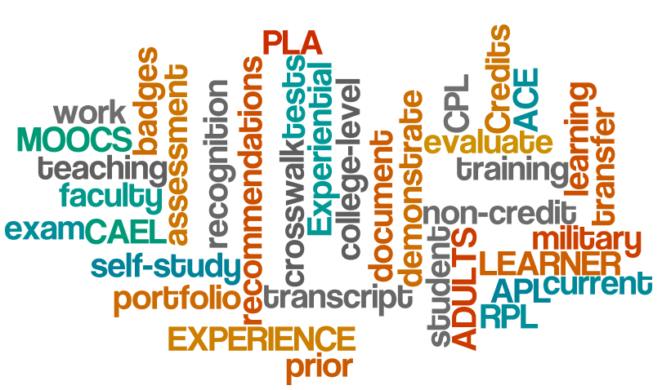
What Is PLA?
Notes:
Even when I put this onto a full screen, it’s out of proportion. Is there any way to change it?
Capitalize Is in title

Slide 15
Four Approaches to PLA
Standardized exams
Challenge exams
Evaluated non-college programs
Individualized assessments

Slide 16
PLA at Your Institution
What is your institution doing?

Slide 17
Standardized Exams
Examples:
CLEP Tests
Excelsior College Exams
DSST Exams

Slide 18
CLEP Exams College Level Examination Program
34 tests
“101”-level material
3-12 credits per exam
Over 5 million users since 1967
http://www.collegeboard.org/

Slide 19
Excelsior College Exams
Excelsior College (New York)
Proficiency-based exams
Exams covering many areas, including nursing
https://www.excelsior.edu/ecapps/exams/creditByExam

Slide 20
DSST Exams
Developed for the military, available to civilians
Nearly 40 exams in many areas
http://www.getcollegecredit.com/
Notes:
Waaahhhhh, lost a bullet here on the first item

Slide 21
Non-college programs
American Council on Education (ACE)
Provides credit recommendations
Hundreds of organizations and programs, military & civilian
http://www.militaryguides.acenet.edu/
http://www2.acenet.edu/credit/?fuseaction=browse.main

Slide 22
Non-college programs
National College Credit Recommendation Service (NCCRS)
Evaluates training programs offered by corporations, unions, religious organizations, and proprietary schools.
Recommendations considered by 1500 colleges and universities
http://www.nationalccrs.org/about/

Slide 23
Challenge Exams
At discretion of institution
Uses locally-developed tests/exams
Comprehensive final exams
can be evaluated for use as
challenge exams
Notes:
Waaaahhhh, lost a bullet!

Slide 24
Individualized Assessments
Portfolio process
Demonstrations/performances
Prior Learning Portfolios: A Representative Collection

Slide 25
Individualized Assessment
Learning Portfolio: Most common individual approach to demonstrating college-level learning
Other methods: Simulations or demonstrations, formal presentations, performance demonstration and faculty interviews
Course-match approach most often used, with growing use of discipline or competency-based approach to documentation and evaluation of learning portfolios for college credit
Discipline specific faculty critical to portfolio and other individualized assessments

Slide 26
Portfolio Assessment
What is a portfolio?
Formal communication prepared and presented by student and presented to college as part of petition requesting credit or recognition for learning outside college classroom
Must make case for credit by identifying learning clearly and succinctly – usually through learning narrative
Provides sufficient supporting information and documentation so that faculty can use it as basis for evaluation
Portfolio course or non-credit workshop usually used
to help students prepare portfolio/s

Slide 27
Meet the Students!
Think about adult students you know who might be good candidates for portfolio.
What makes them good candidates?

Slide 28
What Is the Value of PLA?
CAEL Research:
Fueling the Race to Postsecondary Success: A 48-Institution Study of PLA and Adult Student Outcomes
2010
N=62,475 adult students
PLA usage and academic outcomes

Slide 29
Who Participated
Postsecondary institutions that:
serve many adult learners
offered PLA credit earning options between 2001 and 2008
Notes:
Invited postsecondary institutions to participate in the study.
What we were looking for
Wanted to track cohort over time – explain why.
Received 66 applications. Used a handful of criteria to narrow our list: balance of two and four year, size of institution, location, control.
Also, gave bonus points in selection process to institutions offering portfolio assessments. Explain why: a lot of research showing that portfolio assessments may also have “learning outcomes” . The portfolio method forces the student to process what they have learned in a different way; gain academic and organizational skills. Cognitive outcoomes.

Slide 30
The 48 Institutions
41 four-year, 7 two-year
22 public, 24 private not-for-profit, 2 private for-profit
Range in size from under 1,000 students to more than 20,000
From all regions in the US, with heaviest representation from Mid East, Great Lakes, Plains and Southeast
46 US institutions, 2 Canadian
Notes:
One institution from Oklahoma: Northern Oklahoma College

Slide 31
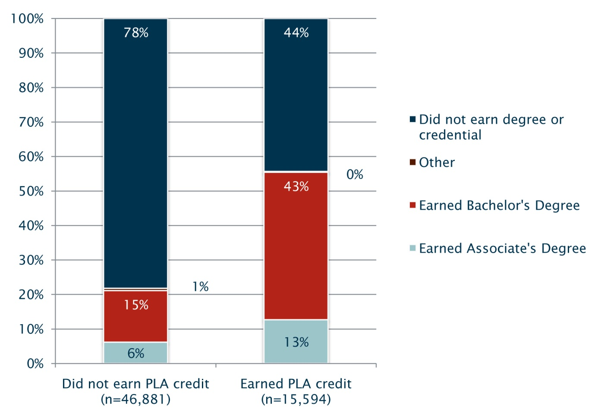
Graduation and Completion

Slide 32
Summary of Graduation Findings
PLA students in this study had better graduation rates than non-PLA students:
regardless of institutional size, level (two-year or four-year) or control (private for-profit, non-profit, or public)
regardless of the individual student’s academic ability or grade point average
regardless of the individual student’s age, gender, or race/ethnicity
regardless of whether or not the individual student receives financial aid

Slide 33
Persistence

Slide 34
Summary of Persistence Findings
PLA students have higher rates of persistence compared with non-PLA students.
In terms of credit accumulation/progress towards the degree
In terms of number of years of credit-earning

Slide 35
Summary of Time to Degree Findings
PLA students earned either a bachelor’s or an associate’s degree in a shorter periods of time compared with non-PLA students.

Slide 36
Prior Learning Assessment
What do regional accreditors say?

Slide 37
North Central Association of Colleges and Schools – HLC
Some Policies Related to Prior Learning Assessment (2012)
The institution evaluates all the credit that it transcripts, including what it awards for experiential learning or other forms of prior Learning
The institution makes readily available to students and the general public clear and complete information including:
d. policies on acceptance of transfer credit, including how credit is applied to degree requirements. (Except for courses articulated through transfer policies or institutional agreements, the institution makes no promises to prospective students regarding the acceptance of credit awarded by examination, credit for prior learning, or credit transfer until an evaluation has been conducted.)
The institution has a clear policy on the maximum allowable credit for prior learning as a reasonable proportion of the credits required to complete the student’s program. Credit awarded for prior learning is documented, evaluated, and appropriate for the level of degree awarded. (Note that this requirement does not apply to courses transferred from other institutions.)

Slide 38
Principle #1
Credit or its equivalent
should be awarded
only for learning,
and not for experience.

Slide 39
Principle #2
Assessment should be based
on standards and criteria
for the level of acceptable learning
that are both agreed upon
and made public.

Slide 40
Principle #3
Assessment should be treated
as an integral part of learning,
not separate from it,
and should be based on an understanding of learning processes.

Slide 41
Principle #4
The determination of credit awards and competence levels must be made by appropriate subject matter and academic or credentialing experts.

Slide 42
Principle #5
Credit or other credentialing
should be appropriate to the context in which it is awarded and accepted.

Slide 43
Principle #6
If awards are for credit,
transcript entries should clearly describe what learning is being recognized and should be monitored to avoid giving credit
twice for the same learning.

Slide 44
Principle #7
Policies, procedures, and criteria applied to assessment, including provision for appeal, should be fully disclosed and prominently available for all parties involved in the assessment process.

Slide 45
Principle #8
Fees charged for assessment
should be based on the services performed in the process and not determined by the amount of credit awarded.

Slide 46
Principle #9
All personnel involved in the assessment of learning should pursue and receive adequate training and continued professional development for the functions they perform.

Slide 47
Principle #10
Assessment programs should be regularly monitored, reviewed, evaluated, and revised as needed to reflect changes in the needs being served, the purposes being met, and the state of the assessment arts.

Slide 48
Implementing/Reviewing a PLA Program
Questions to ask
Accelerating implementation
Assessor training
Best practices in other states

Slide 49
Some Questions
Who are the institutional stakeholders (e.g., faculty, administrators, advisors, registrar, bursar)?
What are the steps necessary to approve and implement PLA in your institution?

Slide 50
Some Questions
How does the institution define PLA? College-level learning?
What are the specific options for earning credit for prior learning?
How will credit for prior learning apply to the degree?
Will all programs/majors accept PLA credit?

Slide 51
Some Questions
How many hours of prior learning credit will apply to the degree?
Who is eligible to apply for prior learning credit?
How will the institution select faculty assessors to evaluate the portfolio?
How will the institution pay faculty?

Slide 52
Some Questions
Who will provide student advising and training? When? How?
What is the cost to the student for assessment of prior learning?
How will PLA credit appear on the transcript?
How will PLA credit transfer?

Slide 53
Accelerating Implementation
A new pathway: LearningCounts.org

Slide 54
CAEL’s New PLA Initiative
LearningCounts.org

Slide 55
LearningCounts.org
On-line platform
Brief assessment of whether LearningCounts.org is appropriate at this time
Training in portfolio preparation
One-on-one advising
On-line portfolio
Portfolio assessment

Slide 56
Assessment Criteria
How can you ensure that they will be uniform, clear, and consistent?
How will the criteria for all PLA opportunities be communicated to assessors, advisors, students, prospective students and (if necessary) accrediting bodies?

Slide 57
Competence-Based/Course-Based: Establishing Common Language
Assessment is
competence-based
when it measures what a student is able to do, based on specific knowledge, within a certain context.
Assessment is
course-based
when it measures what a student knows or is able to do, in alignment with an existing course.

Slide 58
CAEL- Hewlett Practice-based Inquiry Project Findings
CAEL Standards for Assessing Learning | CAEL Standard III. Assessment should be treated as an integral part of learning, not separate from it, and should be based on an understanding of learning processes.
 | V Appropriate to credit context | To make authentic judgments, assessors have competence and context expertise; such integrity honors multiple authorities across experiential contexts. Agreement and transparency ensure integrity and accountability, which rely on criteria that are clear, flexible, and public. Clarity and specificity help reveal students’ thought processes; as such, empathetic understanding of learning processes increases accuracy of assessor judgments. When assessing competence for learning, not experience, guiding criteria are specific, clear, flexible, and easy to use.
 | IV Appropriate expertise
 | II Agreed upon & public standards & criteria
 | I Credit for learning, not experience
 |  | Clarity | Integrity | Flexibility | Empathy
 |  | SNL Qualities of Assessment

Slide 59
What Are Other States Doing?
Some Best Practices

Slide 60
Tennessee
Tennessee Board of Regents (TBR) and University of Tennessee (UT) universities and community colleges :
“…To award and/or transfer credits toward a degree or certificate based on Prior Learning Assessment (PLA), and to provide consistent and accessible methods for students to earn these credits. These terms and conditions apply to the entire institution, including all departments and colleges. Exceptions must be approved by the chief academic officer of the institution. “

Slide 61
Tennessee
Chief academic officers of the state community college system adopted a new CLEP policy in April 2012 that set standardized cutoff scores, hours awarded and course equivalencies, and addressed the transferability of CLEP credit between institutions.

Slide 62
Implications for transfer
Transfer students end up taking 10 more credits than students who don’t transfer to complete their degrees.
U.S. Government Accountability Office, cited by Adult College Completion Network. Strategies for Success: Promising Ideas in Adult College Completion. 2012)

Slide 63
Minnesota
MnSCU
Procedure 3.35.1 Credit for Prior Learning for Board Policy 3.35 (10/08/08)
Part 3. Implementation of Procedure 3.35.1. Each system college and university shall implement a policy and procedure on credit for prior learning …

Slide 64
Colorado
State Board for Community Colleges and Occupational Education
“The State Board supports the concept of life-long learning to meet the retraining, upgrading, and personal enrichment needs of students. It is the policy of the Board that a student’s experience outside the college classroom shall be evaluated for college credit at the student’s request.”

Slide 65
Colorado
Legislation, 2012:
“Beginning in the 2013-14 academic year, each public institution of higher education shall adopt and make public a policy or program to determine academic credit for prior learning.”

Slide 66
Washington
Legislation:
The state board of community and technical colleges must “develop policies for awarding academic credit for learning from work and military experience, military and law enforcement training, career college training, internships and externships, and apprenticeships.”

Slide 67
Oregon
Legislation, 2012
The Higher Education Coordinating Commission shall work with the State Board of Higher Education, community college districts and independent for-profit and not-for-profit institutions of higher education to carry out the following goals:
(a) Increase the number of students who receive academic credit for prior learning and the number of students who receive academic credit for prior learning that counts toward their major or toward earning their degree, certificate or credential, while ensuring that credit is awarded only for high quality course-level
competencies;

Slide 68
Some References
College Productivity: A Resource Guide for State Leaders. CAEL & HCM
http://www.cael.org/pdfs/College-Productivity-Resource-Guide2012
Military guide. American Council on Education
http://www.militaryguides.acenet.edu/
National Guide to College Credit for Workforce Training. American Council on Education
http://www2.acenet.edu/credit

Slide 69
Additional CAEL References
www.cael.org
(Research and Publications)

Slide 70
Additional CAEL References
Brigham, C. and Klein-Collins, R. (2010). Availability, Use and Value of Prior Learning Assessment within Community Colleges. Chicago, IL: CAEL
Colvin, J. (2012).Earn College Credit for What You Know (5th ed.). Dubuque, IA: Kendall/Hunt
Fiddler, M., Marienau, C. & Whitaker, U. (2006). Assessing learning: Standards, principles, and procedures (2nd ed.). Dubuque, IA: Kendall/Hunt

Slide 71
Additional CAEL References
Hart, D.M. and Hickerson, J.H. (2009). Prior Learning Portfolios: A Representative Collection. Chicago, IL: CAEL
Klein-Collins, R. (2012). Competency-based degree programs in the U.S.: Postsecondary credentials for measurable student learning and performance. Chicago, IL: CAEL
Klein-Collins, R. (2010). Fueling the Race to Postsecondary Success. Chicago, IL: CAEL

